Slide 1

Author: Autar Kaw et. al.
TEXTBOOK: NUMERICAL METHODS WITH APPLICATIONS

Slide 2
Newton-Raphson Method

Slide 3
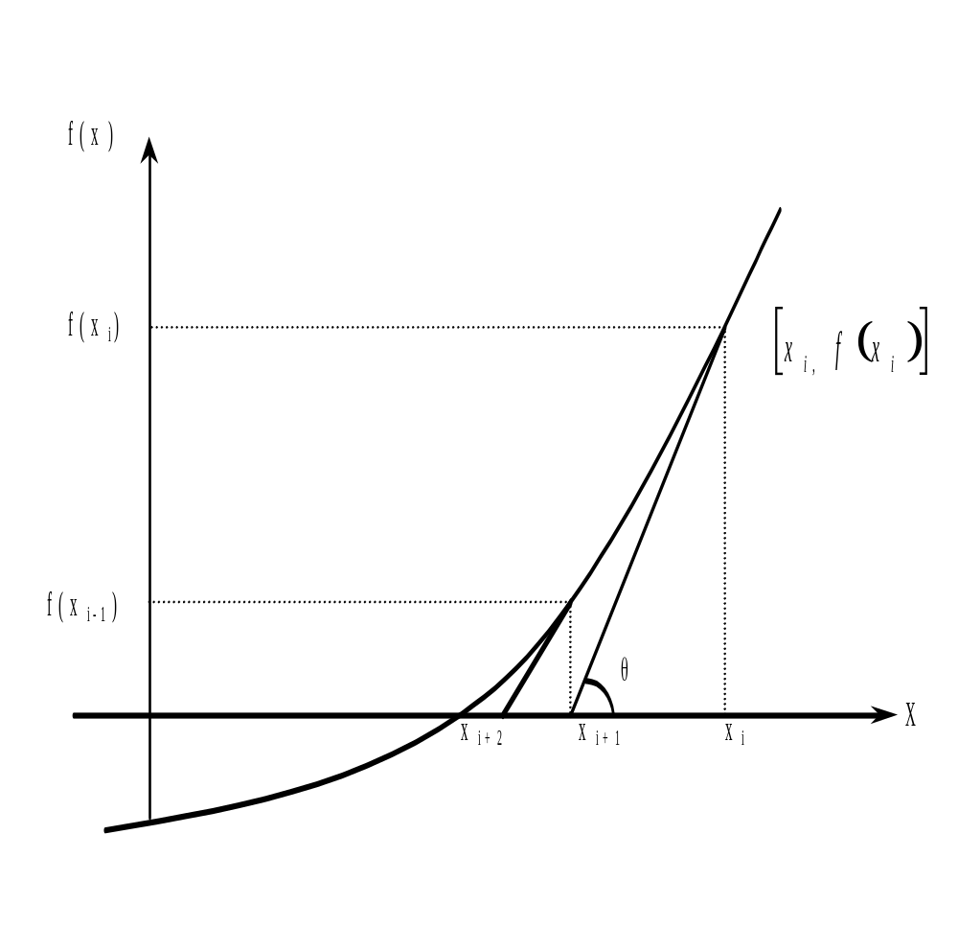
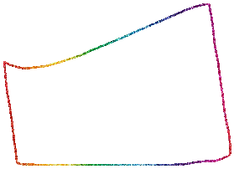

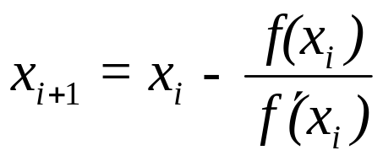




Newton-Raphson Method
Figure 1 Geometrical illustration of the Newton-Raphson method.

Slide 4
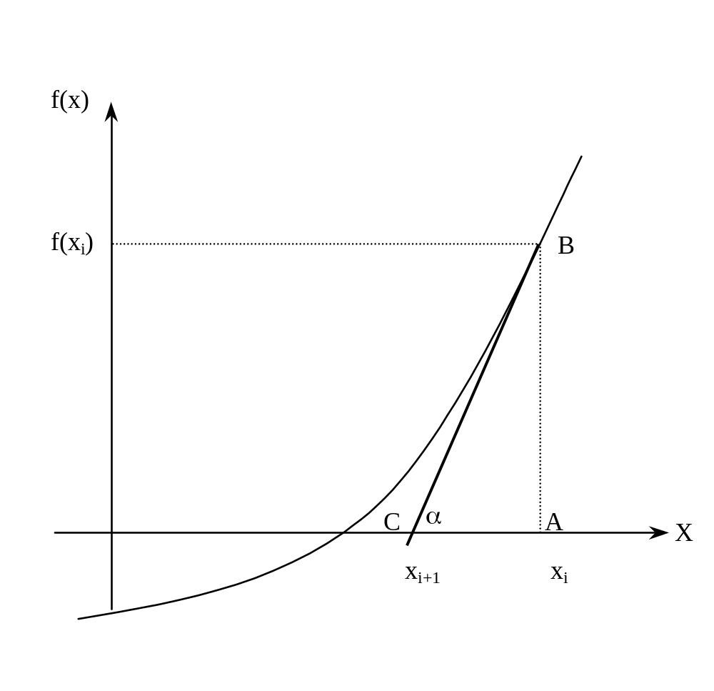
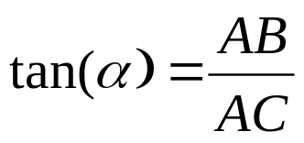
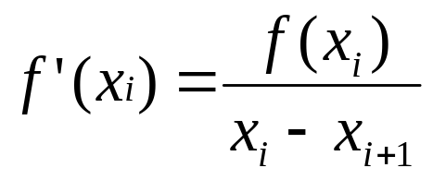
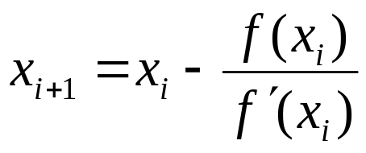


Derivation
Figure 2 Derivation of the Newton-Raphson method.

Slide 5
Algorithm for Newton-Raphson Method

Slide 6

Step 1
Evaluate
symbolically.

Slide 7


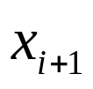
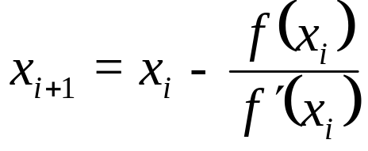
Step 2

Slide 8
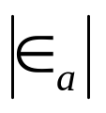

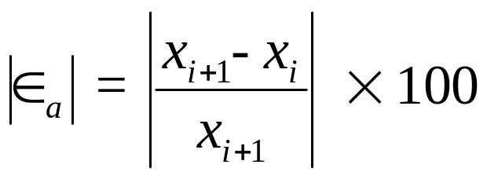


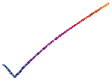
Step 3
Find the absolute relative approximate error as

Slide 9

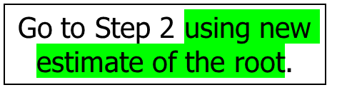


Step 4
Compare the absolute relative approximate error with the pre-specified relative error tolerance .
Also, check if the number of iterations has exceeded the maximum number of iterations allowed. If so, one needs to terminate the algorithm and notify the user.
Yes
Is ?
No
Stop the algorithm

Slide 10

Example 1
You are working for ‘DOWN THE TOILET COMPANY’ that makes floats for ABC commodes. The floating ball has a specific gravity of 0.6 and has a radius of 5.5 cm. You are asked to find the depth to which the ball is submerged when floating in water.
Figure 3 Floating ball problem.

Slide 11

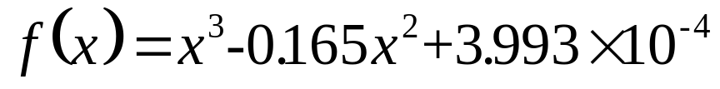
Example 1 Cont.
The equation that gives the depth x in meters to which the ball is submerged under water is given by
Figure 3 Floating ball problem.
Use the Newton’s method of finding roots of equations to find
the depth ‘x’ to which the ball is submerged under water. Conduct three iterations to estimate the root of the above equation.
The absolute relative approximate error at the end of each iteration, and
The number of significant digits at least correct at the end of each iteration.

Slide 12
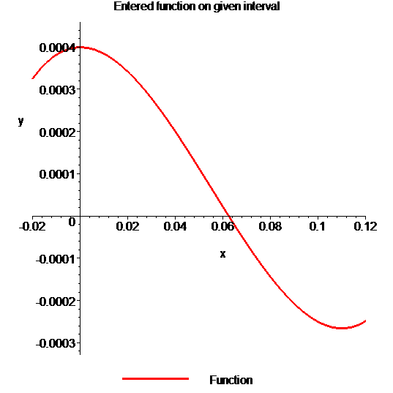
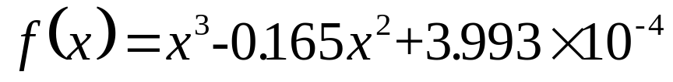
Example 1 Cont.
Solution
To aid in the understanding of how this method works to find the root of an equation, the graph of f(x) is shown to the right,
where
Figure 4 Graph of the function f(x)

Slide 13

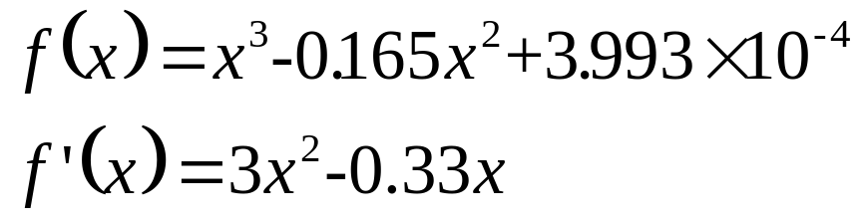



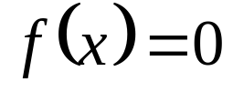
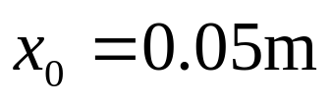


Example 1 Cont.
Solve for
Let us assume the initial guess of the root of is . This is a reasonable guess (think why
and are not good choices) as the extreme values of the depth x would be 0 and the diameter (0.11 m) of the ball.

Slide 14
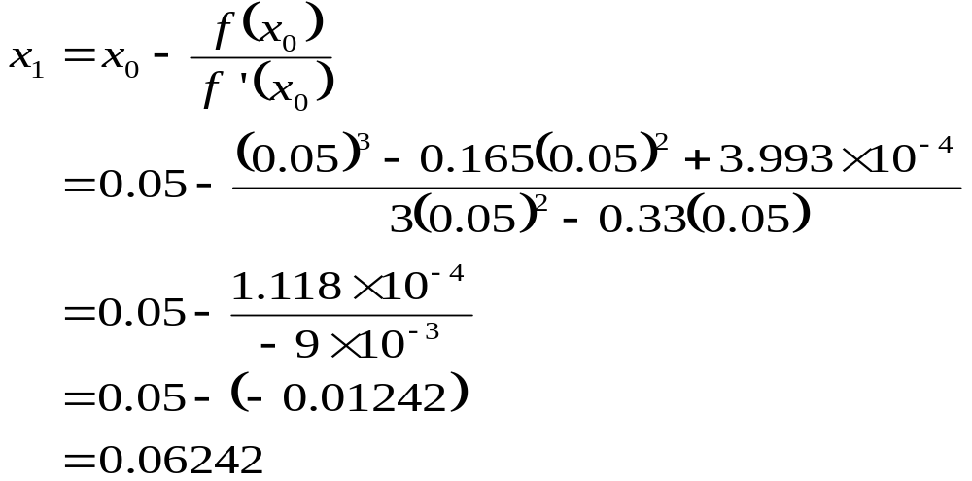

Example 1 Cont.
Iteration 1
The estimate of the root is

Slide 15
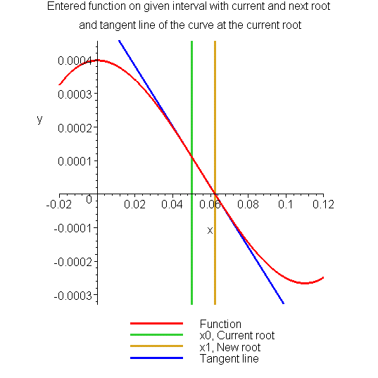
Example 1 Cont.
Figure 5 Estimate of the root for the first iteration.

Slide 16

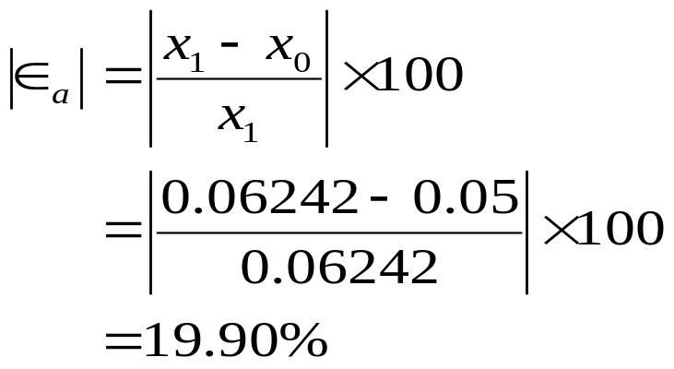


Example 1 Cont.
The absolute relative approximate error at the end of Iteration 1 is
The number of significant digits at least correct is 0, as you need an absolute relative approximate error of 5% or less for at least one significant digits to be correct in your result.

Slide 17
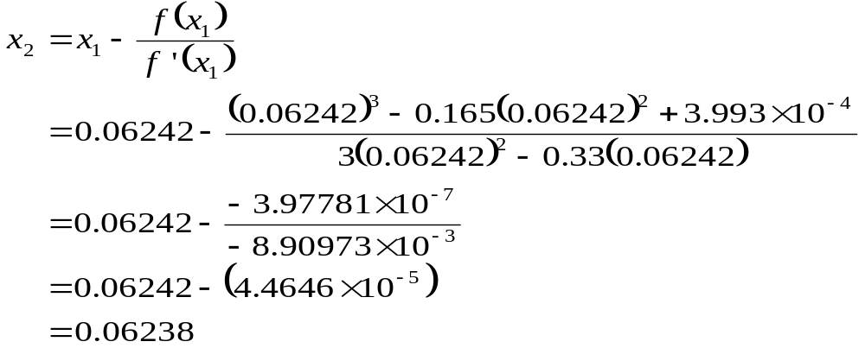
Example 1 Cont.
Iteration 2
The estimate of the root is

Slide 18
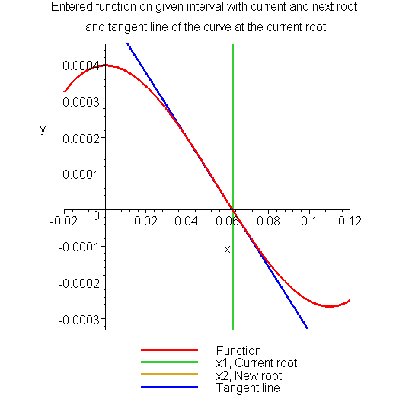
Example 1 Cont.
Figure 6 Estimate of the root for the Iteration 2.

Slide 19
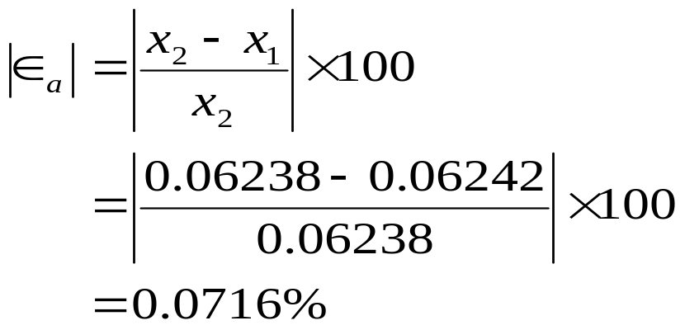




Example 1 Cont.
The absolute relative approximate error at the end of Iteration 2 is
The maximum value of m for which is 2.844. Hence, the number of significant digits at least correct in the answer is 2.

Slide 20
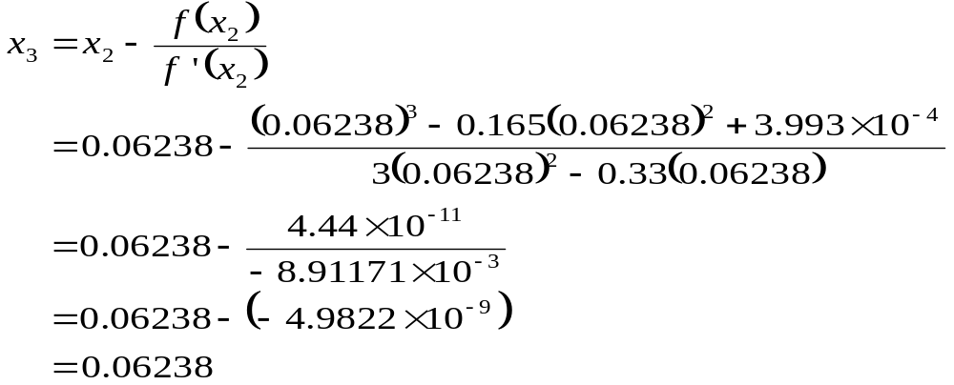
Example 1 Cont.
Iteration 3
The estimate of the root is

Slide 21
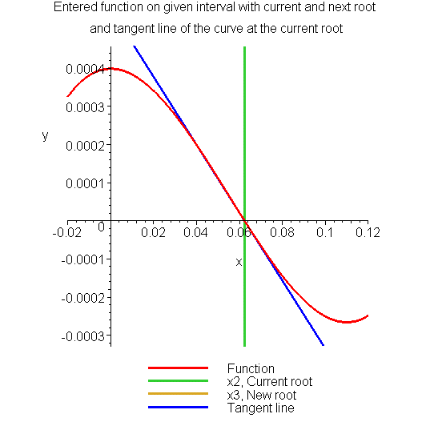
Example 1 Cont.
Figure 7 Estimate of the root for the Iteration 3.

Slide 22
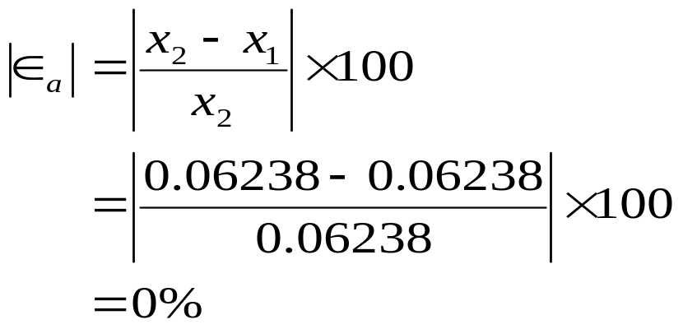


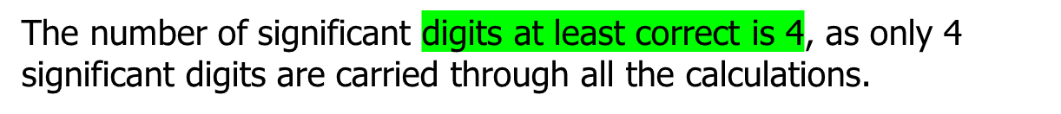
Example 1 Cont.
The absolute relative approximate error at the end of Iteration 3 is

Slide 23
Advantages and Drawbacks of Newton Raphson Method

Slide 24
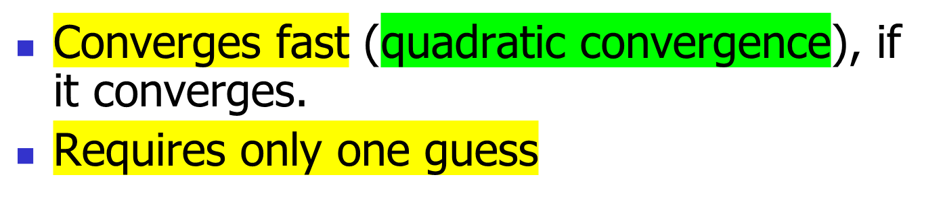

Advantages

Slide 25
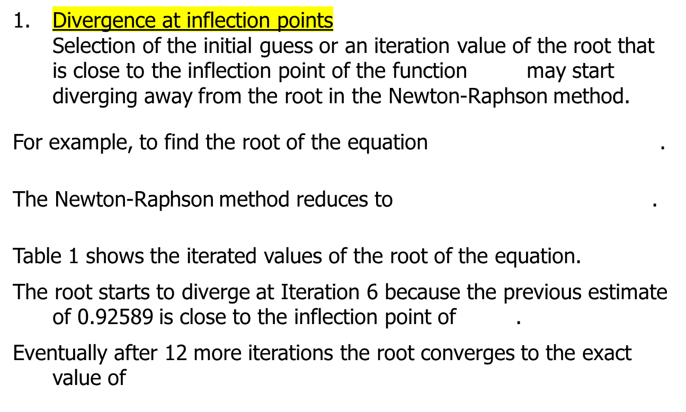


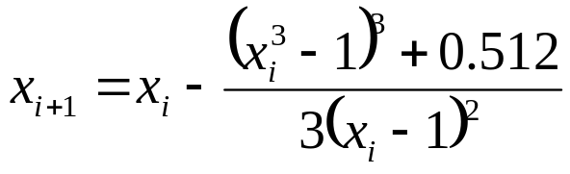


Drawbacks

Slide 26
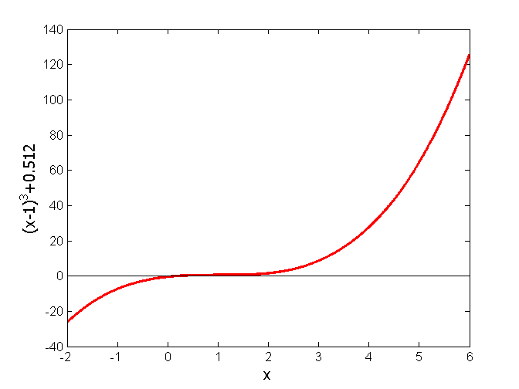


Drawbacks – Inflection Points
Table 1 Divergence near inflection point.
Iteration Number | x_{i}
0 | 5.0000
1 | 3.6560
2 | 2.7465
3 | 2.1084
4 | 1.6000
5 | 0.92589
6 | −30.119
7 | −19.746
18 | 0.2000
Figure 8 Divergence at inflection point for

Slide 27
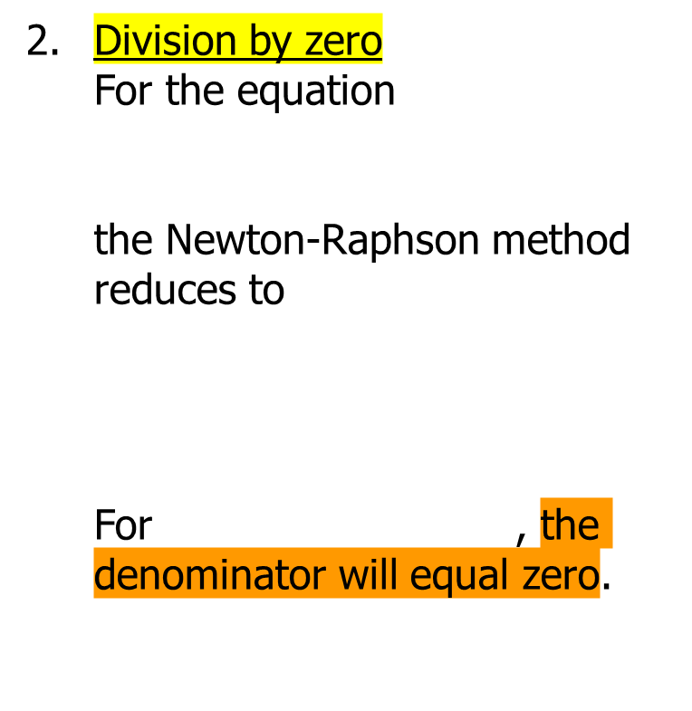
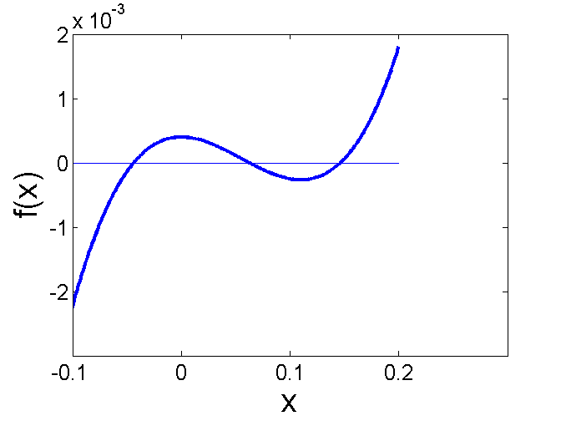

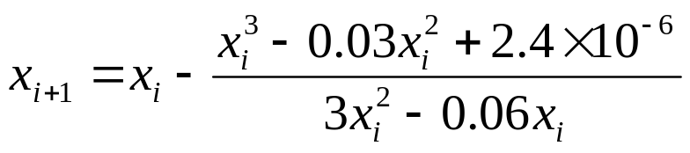

Drawbacks – Division by Zero
Figure 9 Pitfall of division by zero or near a zero number

Slide 28

Drawbacks – Oscillations near local maximum and minimum
Results obtained from the Newton-Raphson method may oscillate about the local maximum or minimum without converging on a root but converging on the local maximum or minimum.
Eventually, it may lead to division by a number close to zero and may diverge.
For example for the equation has no real roots.

Slide 29
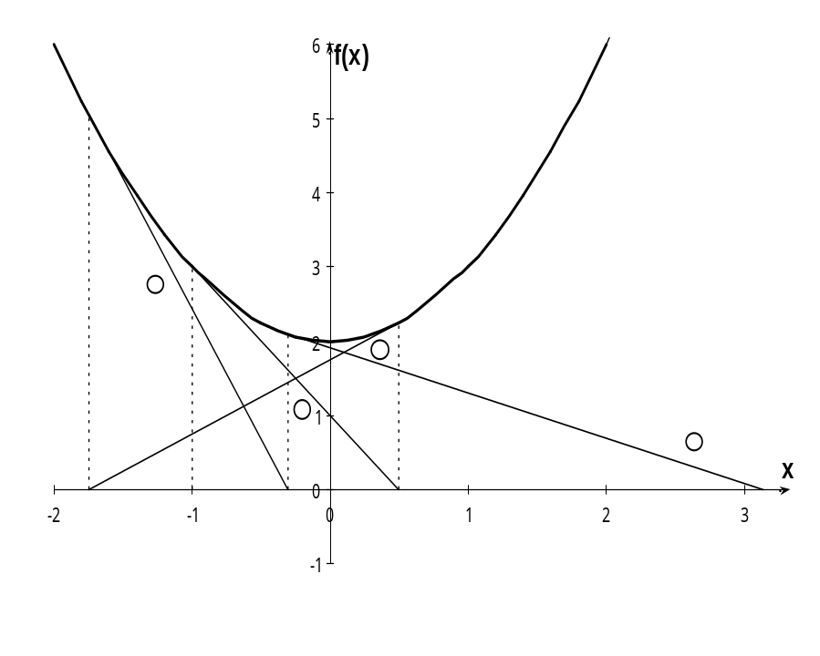

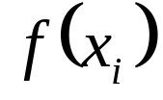
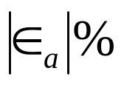


Drawbacks – Oscillations near local maximum and minimum
Table 3 Oscillations near local maxima and mimima in Newton-Raphson method.
Iteration Number
0 1 2 3 4 5 6 7 8 9 | –1.0000 0.5 –1.75 –0.30357 3.1423 1.2529 –0.17166 5.7395 2.6955 0.97678 | 3.00 2.25 5.063 2.092 11.874 3.570 2.029 34.942 9.266 2.954 | 300.00 128.571 476.47 109.66 150.80 829.88 102.99 112.93 175.96

Slide 30
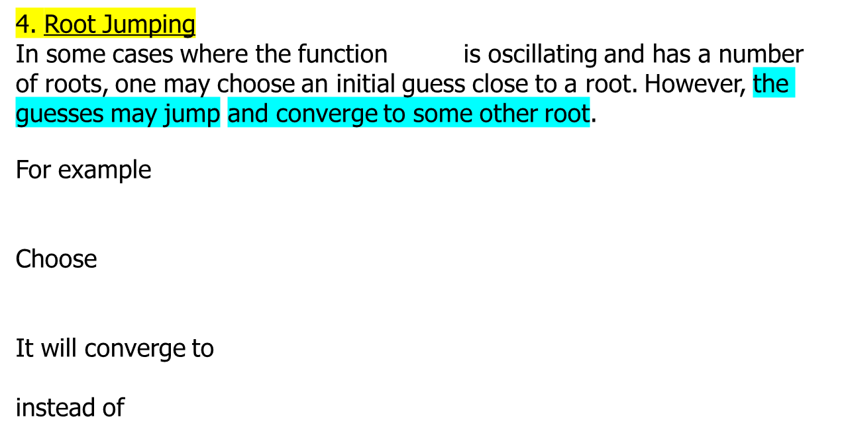

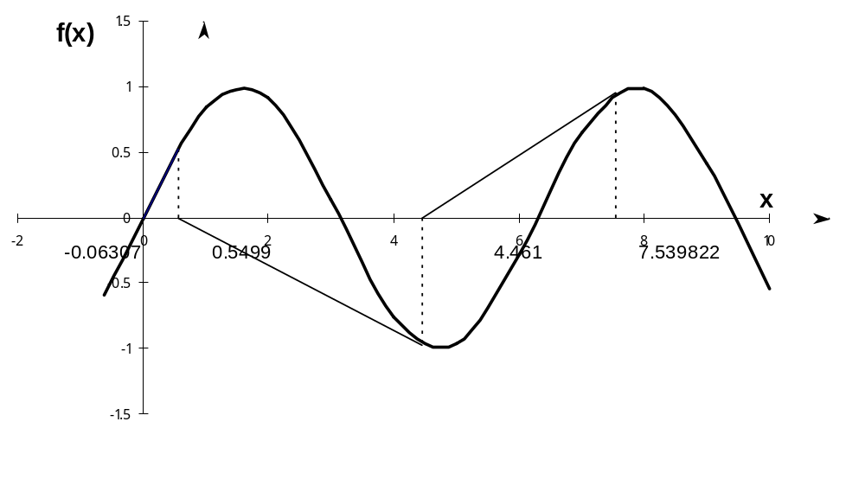




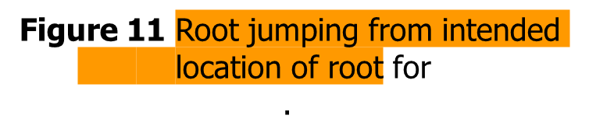


Drawbacks – Root Jumping

Slide 31
THE END

